Slide 1
“What’s in it for me?” Lead Generation 24x7
Or
How digital agencies sell you what you know already!
https://www.linkedin.com/in/robertmoloney/
https://www.facebook.com/SellingSolutions.ie

Slide 4
"Most Irish SMEs, are unwittingly making their websites hard to find. Unless a customer is searching for a specific business in a specific area, an SME is unlikely to be found." - iedr. Digital Health Report 2019

Slide 5
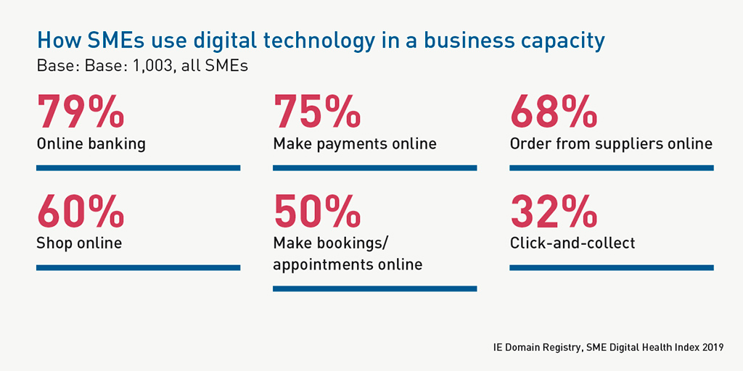

Slide 7
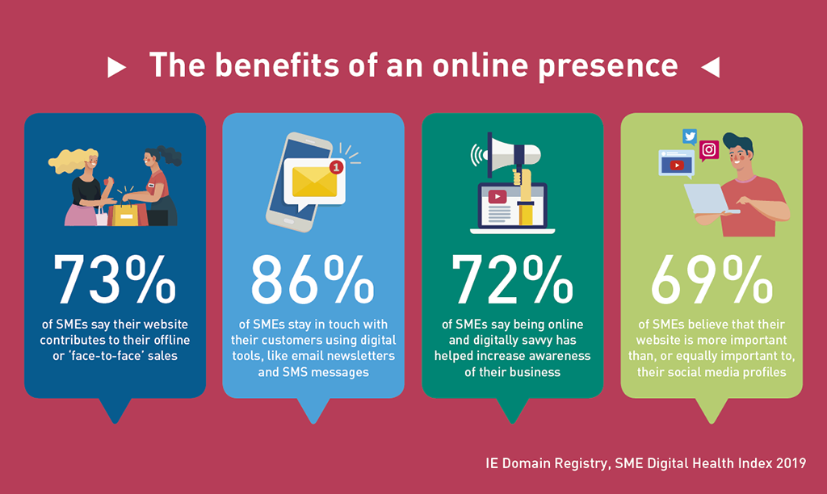

Slide 8
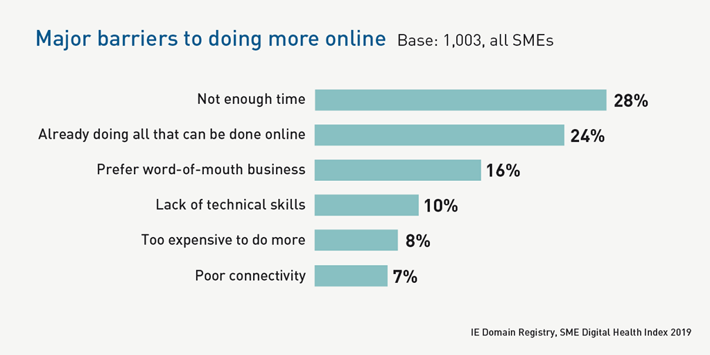

Slide 9
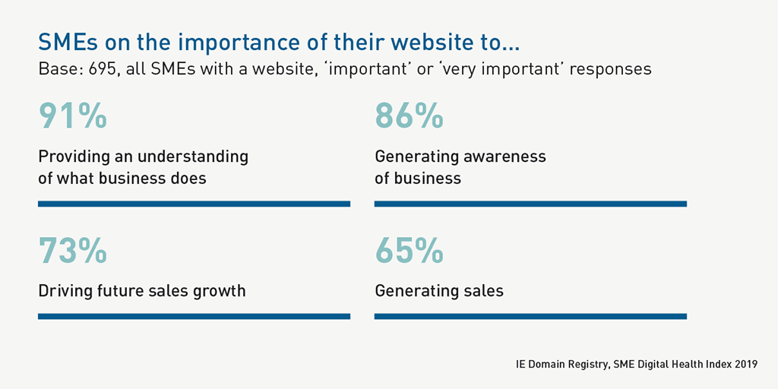

Slide 10
“In order for you to achieve first-page rankings, you have to be better than the guys on the first page. And that’s all of these; you have to index better, your content has to be better, your technical superiority has to be better, but more than that, your digital footprint has to be better”
How do you Sell?
Are you worth finding?
Nurture? Close?
Generate interest
Present
Close
Sales

Slide 11
?
I’m bored now

Slide 12
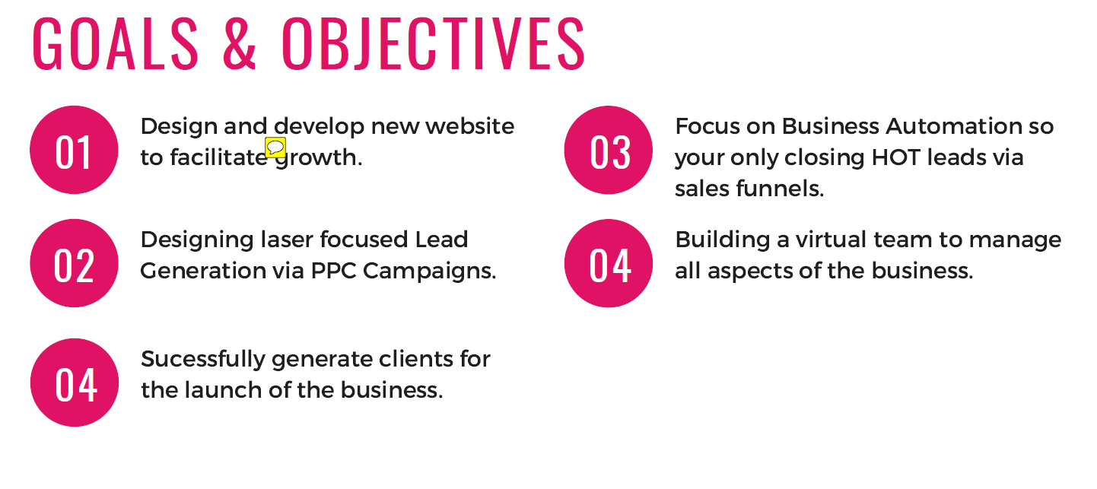

Slide 13
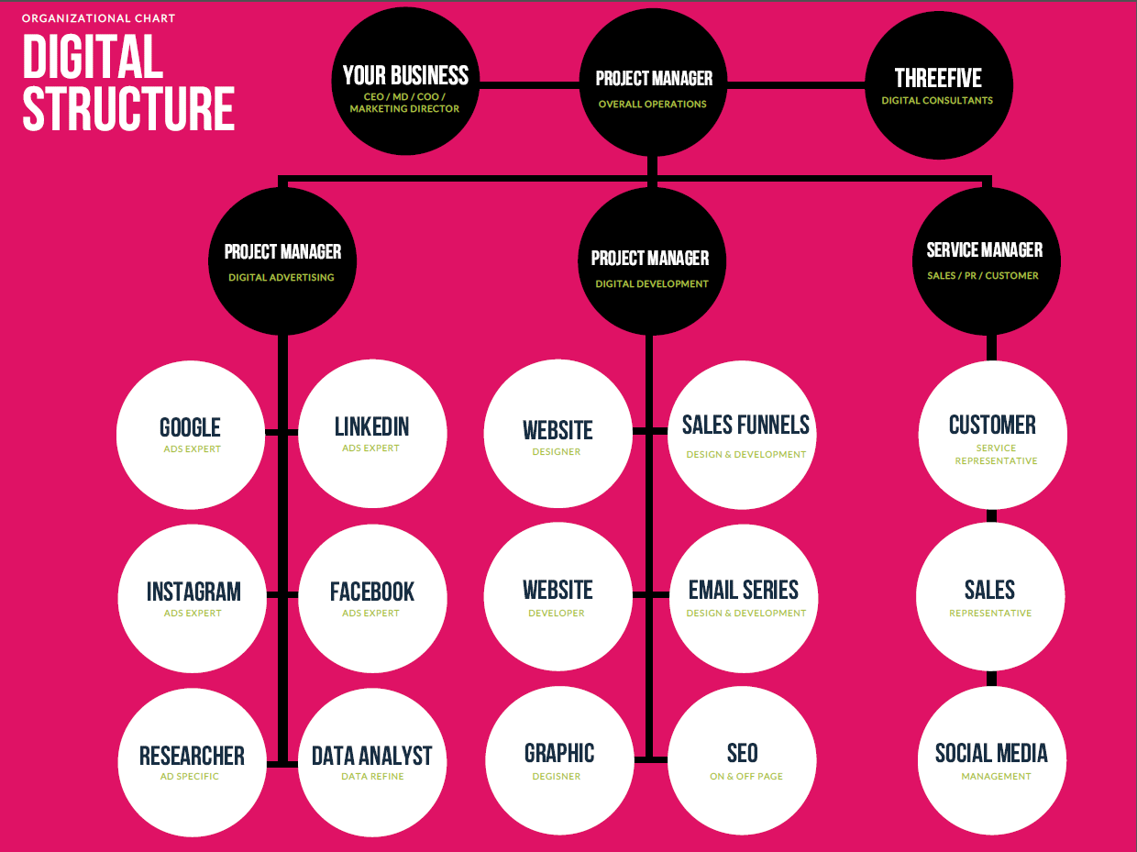

Slide 14
